Slide 1


PC406/PC407
BTech Mini Project
Title: Elective Registration System
Group Members :
  Parth Vadodaria - 202201174 (ICT)
  Hitanshu Variya - 202201510 (ICT + CS)
Under the guidance of Prof. Abhishek Gupta & Prof. PM Jat

Slide 2

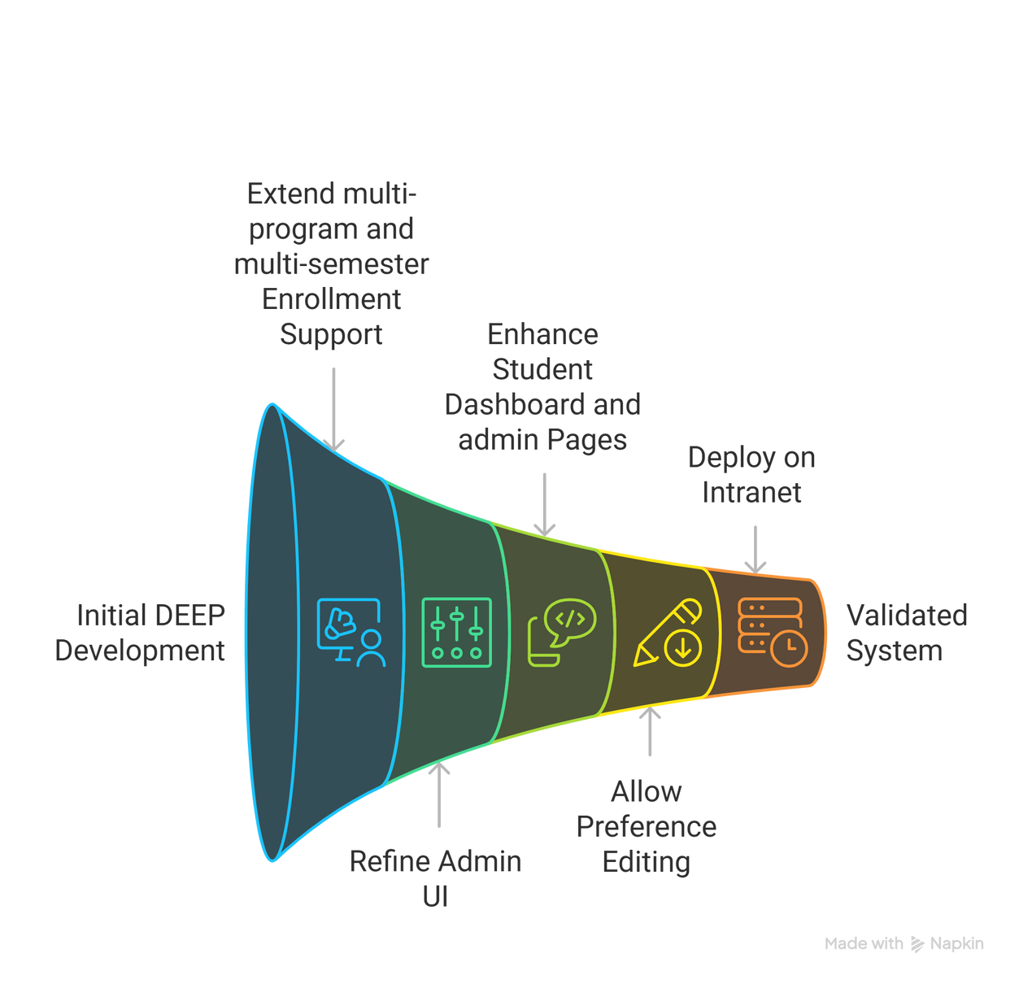
Objectives
2

Slide 3
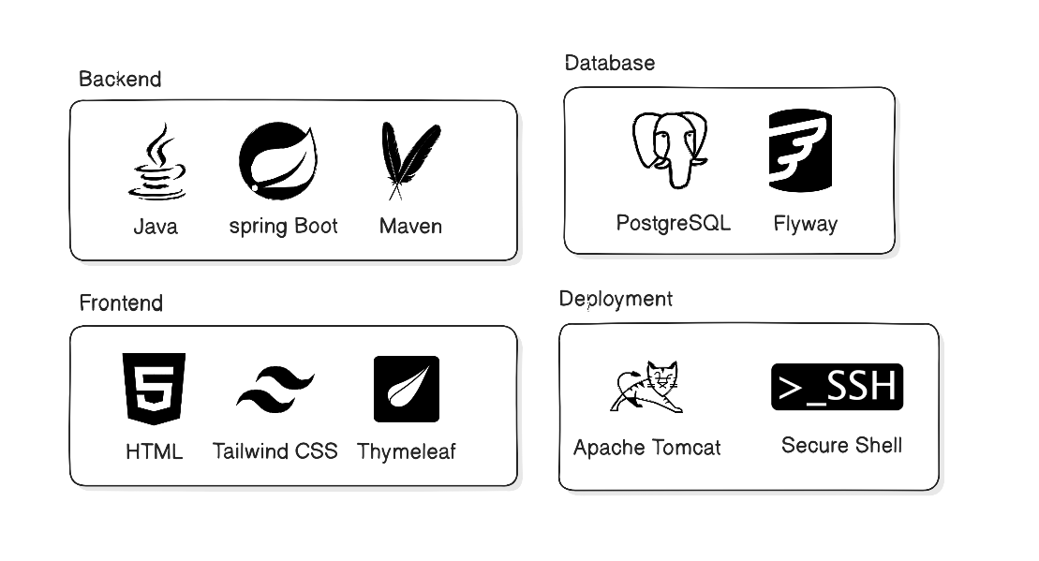
Tech Stack
3

Slide 4
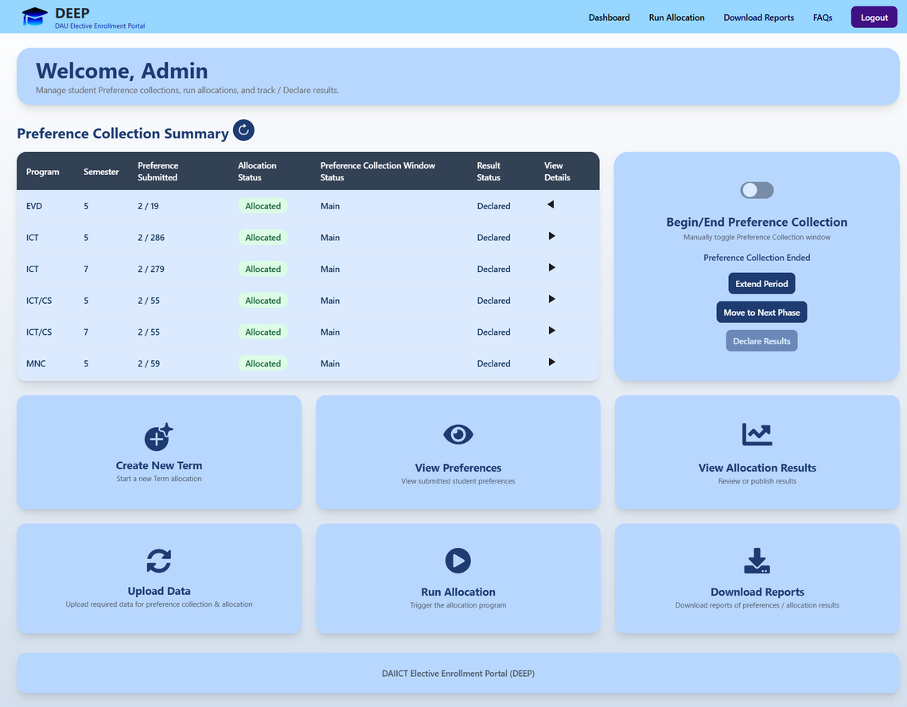
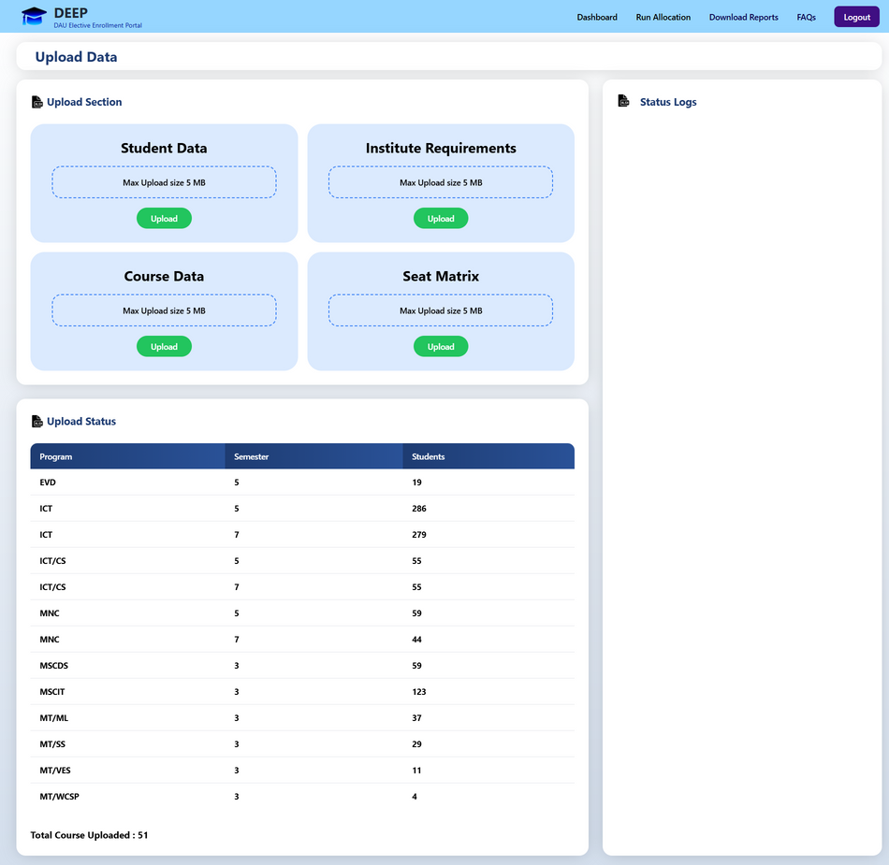
Admin Dashboard
Upload Data
4

Slide 5
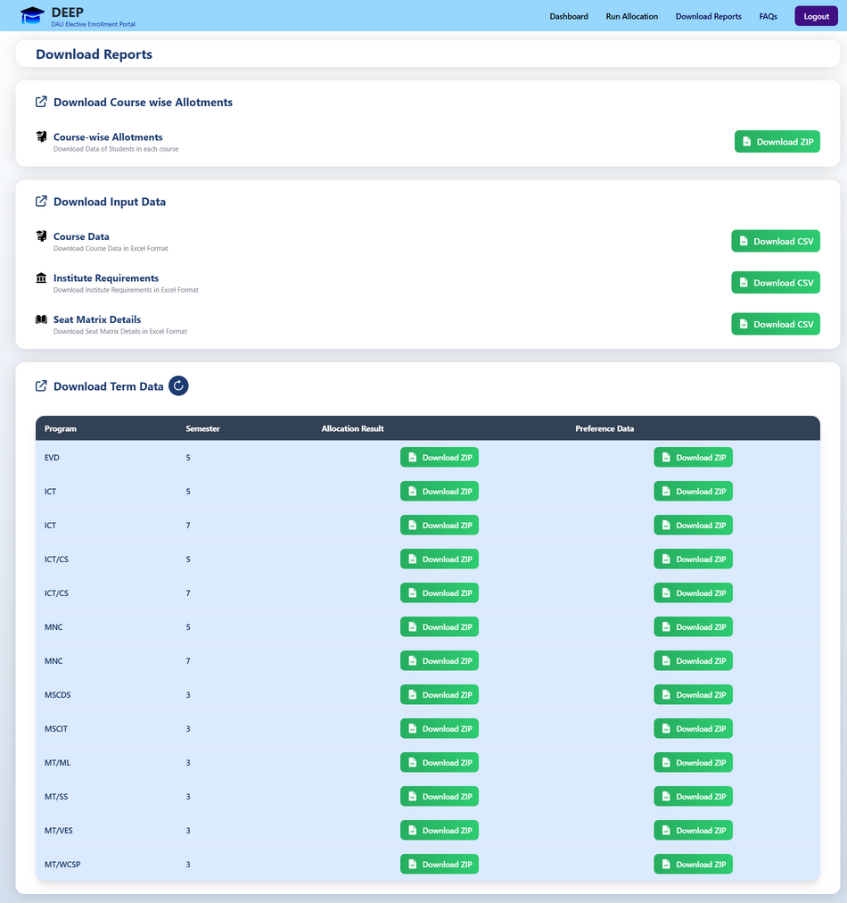
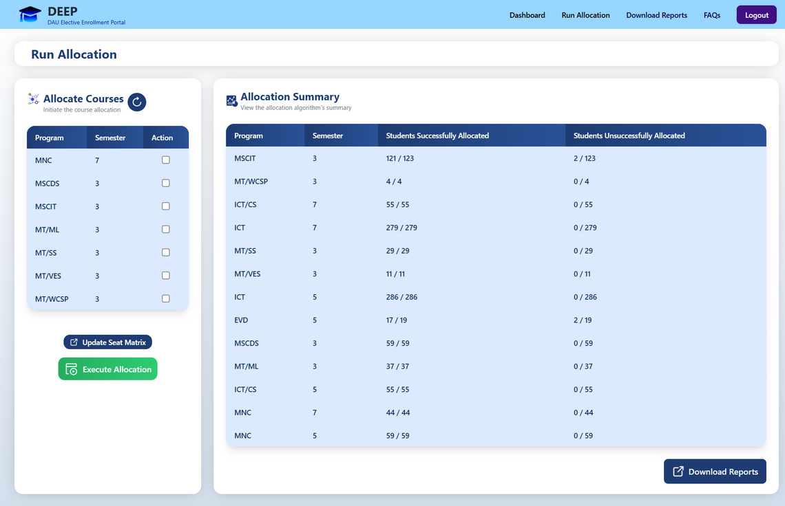
Run Allocation
Download Reports
5

Slide 6
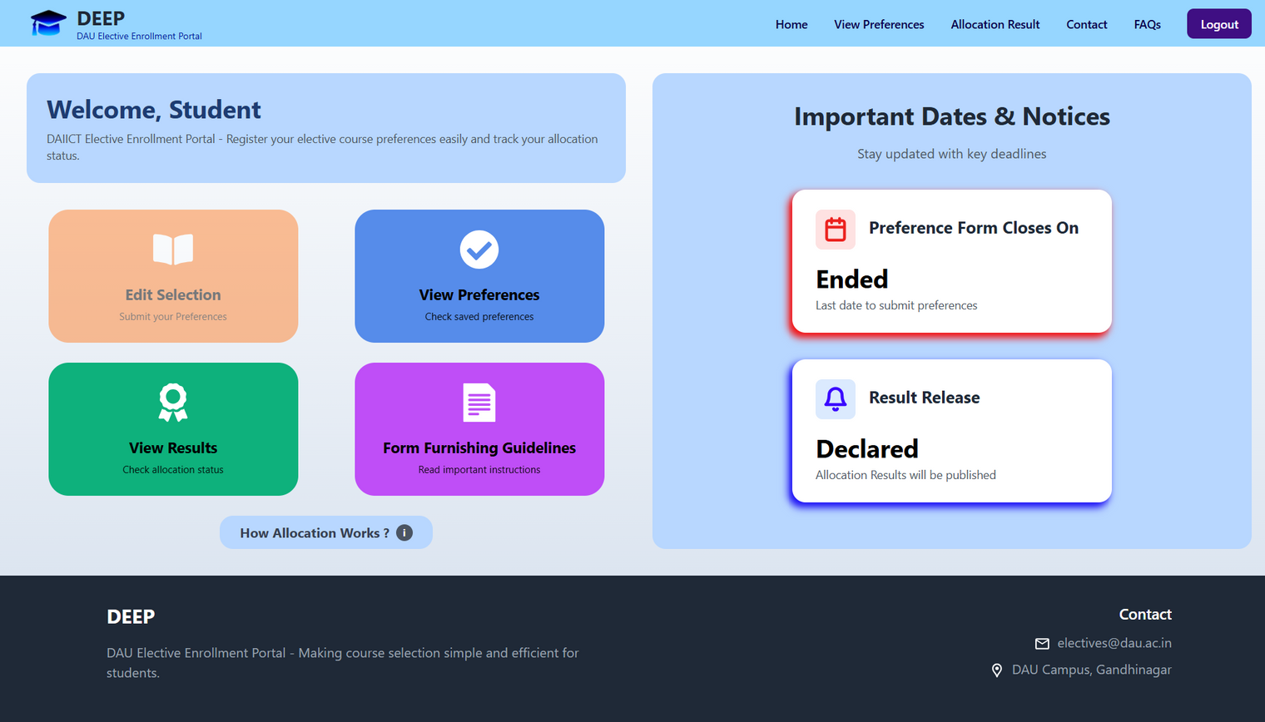
Student Dashboard
6

Slide 7
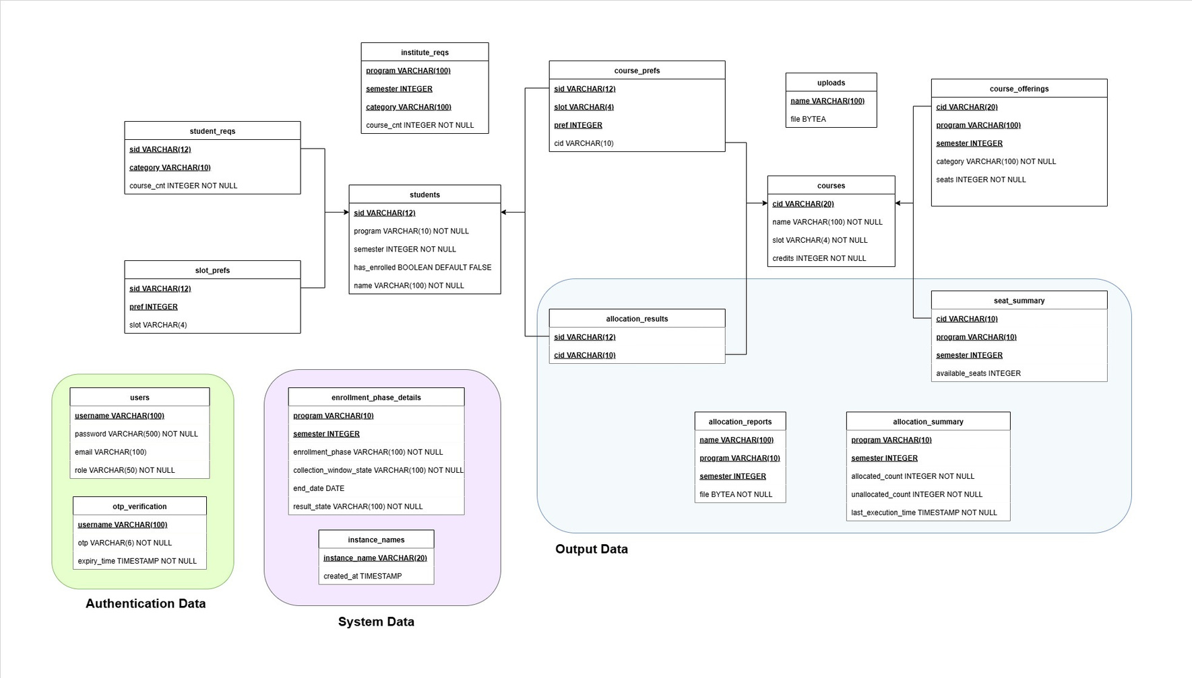
DataBase Schema
7

Slide 8
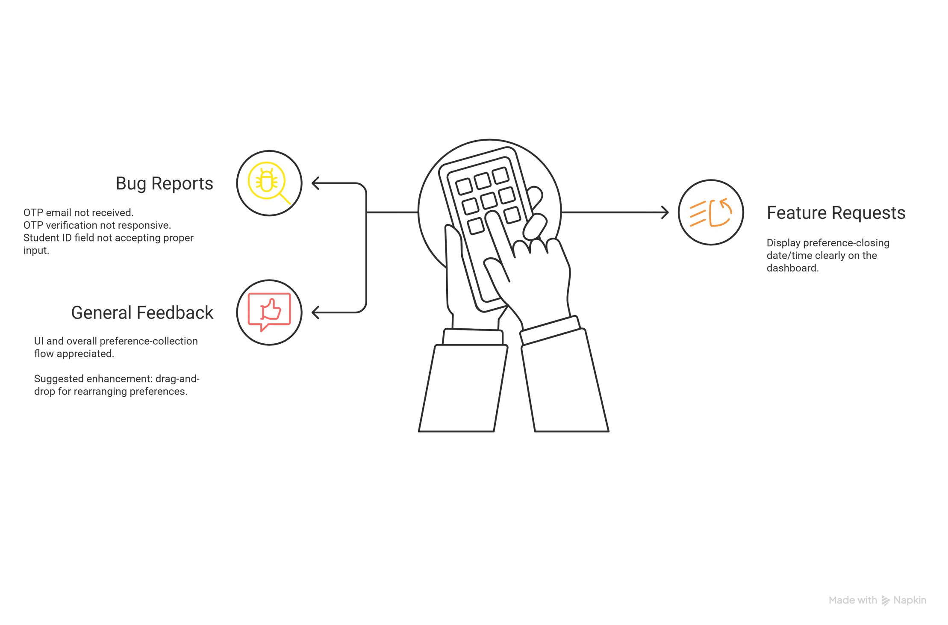
User Testing Feedbacks (Among 7-10 peers)
8

Slide 9
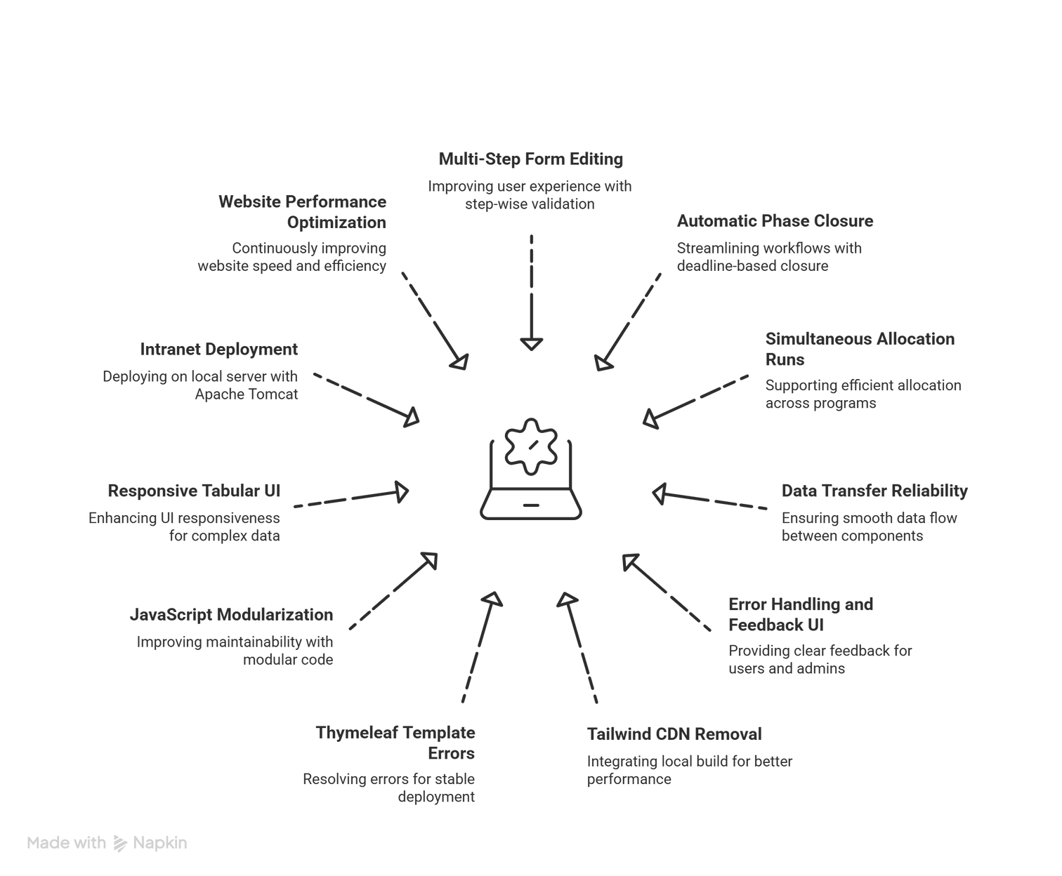
Challenges
9

Slide 10
Group Contribution
  Testing & Validation – Conducted student testing among 7-10 peers to validate functionality, usability, and performance improvements.
Parth’s Contribution
Hitanshu’s Contribution
  Backend Development: Enhanced backend logic to support multi-program and multi-semester workflows, updated allocation execution for simultaneous checkbox-based runs, and improved data handling for form editing, preference updates, and consistency.
  Deployment – Deployed the system on the institute’s server.
  Refined Student Dashboard and Admin: Pages with dynamic phase-aware UI, responsive multi-program/semester tables, persistent error feedback, modularized JavaScript, and replaced Tailwind CDN with a local minified build.
  Accessibility & UX – Ensured smooth interaction and cross-device usability.
10

Slide 11
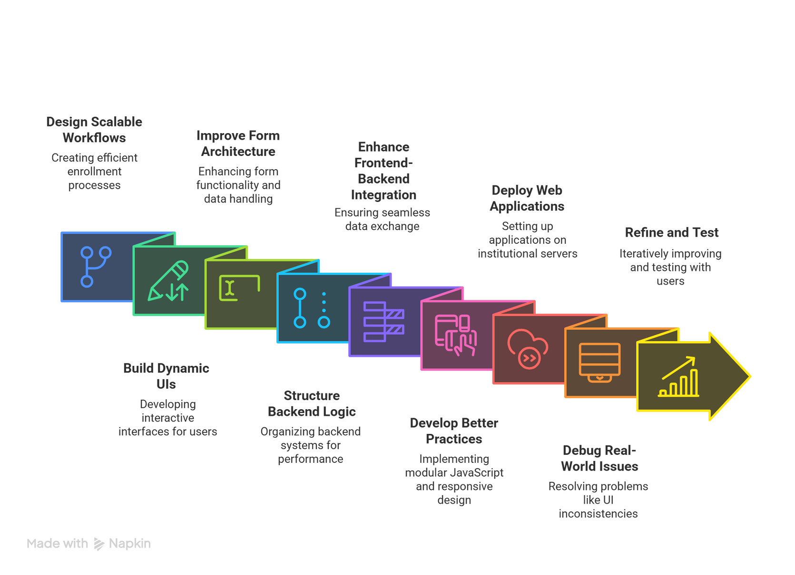
Learning Outcomes
11

Slide 12
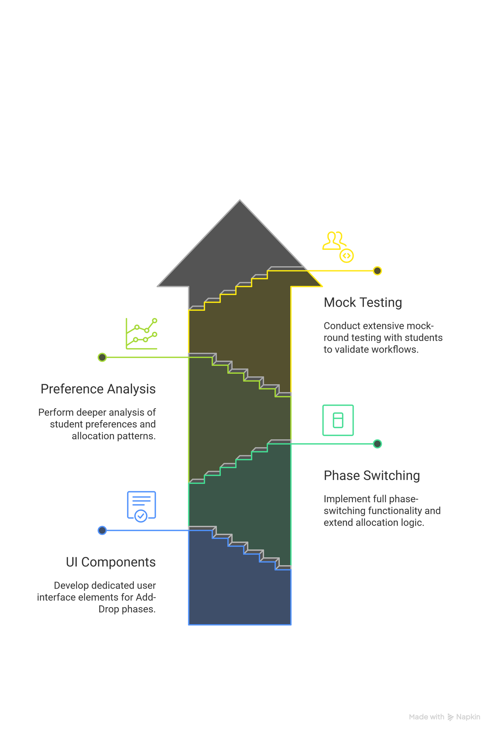
Future Works
12

Slide 13
Thank you!
Deployed Link: http://ers.daiict.ac.in:8090/

